Slide 1




Synopsis Presentation on
QUIZ SYSTEM
Guided By:
Prof. Varsha Choudhary
Presented By:
Hariom Mandloi (0827CD221033)
Deepak Patel (0827CD221023) Deepak Patel (0827CD221024)
Shubham Siloriya(0827CD221068)

Slide 2
Contents
Introduction
Overview
Purpose
Literature Review
Problem Statement
Proposed Solution
Objectives
Theoretical Analysis
Block Diagram
Hardware Requirements
Software Requirements
Applications
REFERENCES

Slide 3
1. Introduction
.
Overview
Quiz System is a software application designed to create, manage, and evaluate quizzes for educational, training, or entertainment purposes. It typically involves roles like Admin/Teacher, Student/User, and sometimes Evaluator/Moderator. It offers a user-friendly interface for students to attempt quizzes and get immediate results. The system also includes an admin panel for managing quiz questions.
Purpose
The purpose of a quiz system is to evaluate knowledge, skills, or learning progress through structured questions. It helps in conducting assessments efficiently, providing instant feedback, and improving learning outcomes. Quiz systems are widely used in education, corporate training, and recruitment to support objective and scalable evaluation. It helps in conducting assessments efficiently, saving time and resources. The platform can be used in schools, colleges, and online learning environments for evaluations and self-assessments.

Slide 4
2. Literature Review
Currently available systems for Quizzes
Sr. No. | Name of Solution/System | Features | Limitations/ Drawbacks
1 | Quiz System | Clean, structured interface Centralized database(MangoDB) Good for academic purpose and training use | Needs internet and hosting environment Admin needs technical knowledge
2 | Google form | Easy to create quiz No coding required | Limited customization Less interactivity Not ideal for exams
3 | Kahoot | Game-based quizzes Attractive visual and sound effects | Paid services Less suitable for formal and academic assessment

Slide 5
3. Problem Statement
The traditional approach to conducting quizzes and assessments in educational institutions still heavily relies on pen-and-paper methods or simple online forms. This creates several inefficiencies and limitations. Teachers and administrators often face a significant workload due to the manual preparation, distribution, collection, and grading of quizzes. The process becomes even more cumbersome when dealing with large groups of students. Additionally, students do not receive real-time feedback, which can delay their learning progress and reduce the effectiveness of assessments.
Accessibility is another major issue, as traditional exams often require physical presence, making it challenging for remote learners or during situations like the COVID-19 pandemic. Even digital alternatives like Google Forms lack proper security features and are prone to cheating or manipulation. Furthermore, there is no centralized system for storing questions, tracking quiz attempts, or analyzing student performance over time. These shortcomings highlight the need for a secure, efficient, and automated solution that benefits both educators and learners.

Slide 6
4. Proposed Solution
To overcome the limitations of traditional quiz systems, we propose a web-based Online Quiz System that allows users to take quizzes online and receive instant results. The platform will use HTML, CSS, and JavaScript for the frontend, with Node.js and Express.js handling the backend, and MongoDB managing the database.
The system will include an admin panel where authorized users can log in and manage quiz content by adding, editing, or deleting questions. It will offer a user-friendly interface, quick performance evaluation, and a centralized database for storing questions and responses. This solution reduces manual workload, enhances accessibility, and provides a more efficient and secure way to conduct assessments.

Slide 7
5. Objective:
The primary objective of this project is to design and develop an interactive and user-friendly Online Quiz System that simplifies the process of conducting quizzes and assessments. The system aims to:
Provide a digital platform for students or users to take quizzes online from any location.
Enable instant evaluation and feedback to enhance the learning experience.
Allow administrators to manage quiz content efficiently through a secure admin panel.
Maintain a centralized database for storing questions, responses, and user scores.
Ensure accessibility, reduce manual effort, and improve the overall efficiency of the examination process.

Slide 8
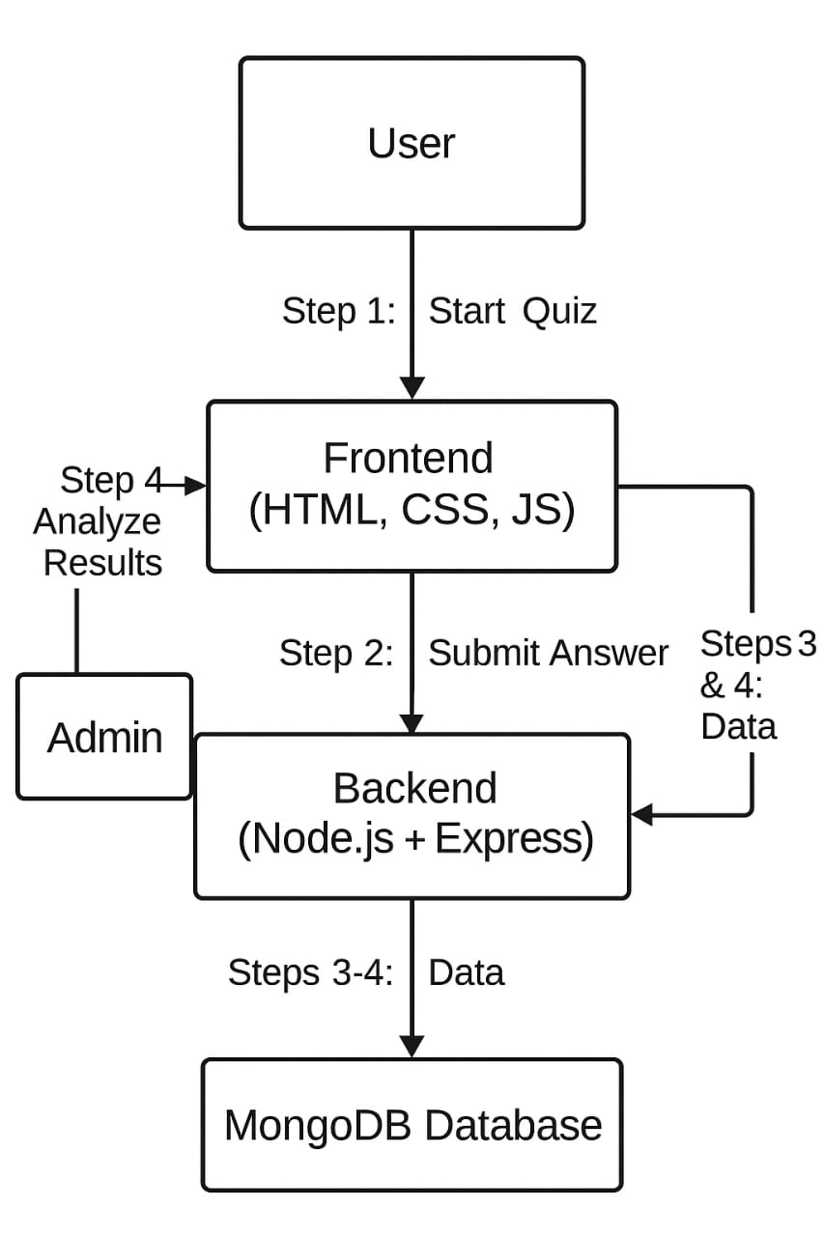
6. Theoretical Analysis
Fig. Block Diagram of Quiz System

Slide 9
6. Theoretical Analysis
6.2 Hardware Requirements
Server Hardware: -
Processor: Intel i3/ i5/i7, Ryzen 3/5/7 or higher.
RAM: Minimum 8 GB.
Storage: SSD with at least 100 GB.
Network: High-speed internet, minimum 100 Mbps
Backup: External storage or cloud backup support
For Client Devices (Users):
Device: Smartphone, tablet, laptop, or desktop
RAM: 2 GB or more
Internet: Stable connection, minimum 2 Mbps.

Slide 10
6.3 Software Requirements
Operating System: Linux or Windows Server
Frontend: HTML5, CSS3, JavaScript.
Libraries/Frameworks: React, Angular, Vue.js (optional
Backend Language: Node.js
Database: MongoDB
Frameworks: Laravel, Django, Express, etc.

Slide 11
7. Applications
Educational Institutions
Conduct online exams, practice tests, and assignments.
Evaluate students’ understanding and track progress.
Corporate Training
Assess employee learning during training programs.
Conduct skill tests and compliance quizzes.
Recruitment & Hiring
Pre-screen candidates using aptitude and technical quizzes.
Automate the first round of assessments.
E-Learning Platforms
Offer interactive quizzes for learners to test their knowledge.
Provide immediate feedback and performance analytics
Competitive Exam Preparation
Simulate real test environments for exams like GRE, IELTS, etc.
Provide practice with time limits and scoring.

Slide 12
E-Learning Platforms
Offer interactive quizzes for learners to test their knowledge.
Provide immediate feedback and performance analytics
Competitive Exam Preparation
Simulate real test environments for exams like GRE, IELTS, etc.
Provide practice with time limits and scoring.

Slide 13
REFERENCES
[1] Moodle Documentation – Moodle Quiz Module, https://docs.moodle.org
[2] Google Forms Help – Create a quiz with Google Forms, https://support.google.com
[3] Black, P., & Wiliam, D. (1998). Assessment and classroom learning. Assessment in Education: Principles, Policy & Practice, 5(1), 7–74.

Slide 14
[4] Anderson, L. W., & Krathwohl, D. R. (2001). A Taxonomy for Learning, Teaching, and Assessing: A Revision of Bloom's Taxonomy of Educational Objectives. [5] Kahoot! – Game-based learning platform, https://kahoot.com

Slide 15
Github link:-
https://github.com/hariiom08/Minor-project-2

Slide 16



Queries ?
17

